Slide 1
Candy 24 bits RISC-V style CPU Part 2: Arithmetic Logic Unit
Zhiwei Luo & Qingruo Si
2018.12.05

Slide 2
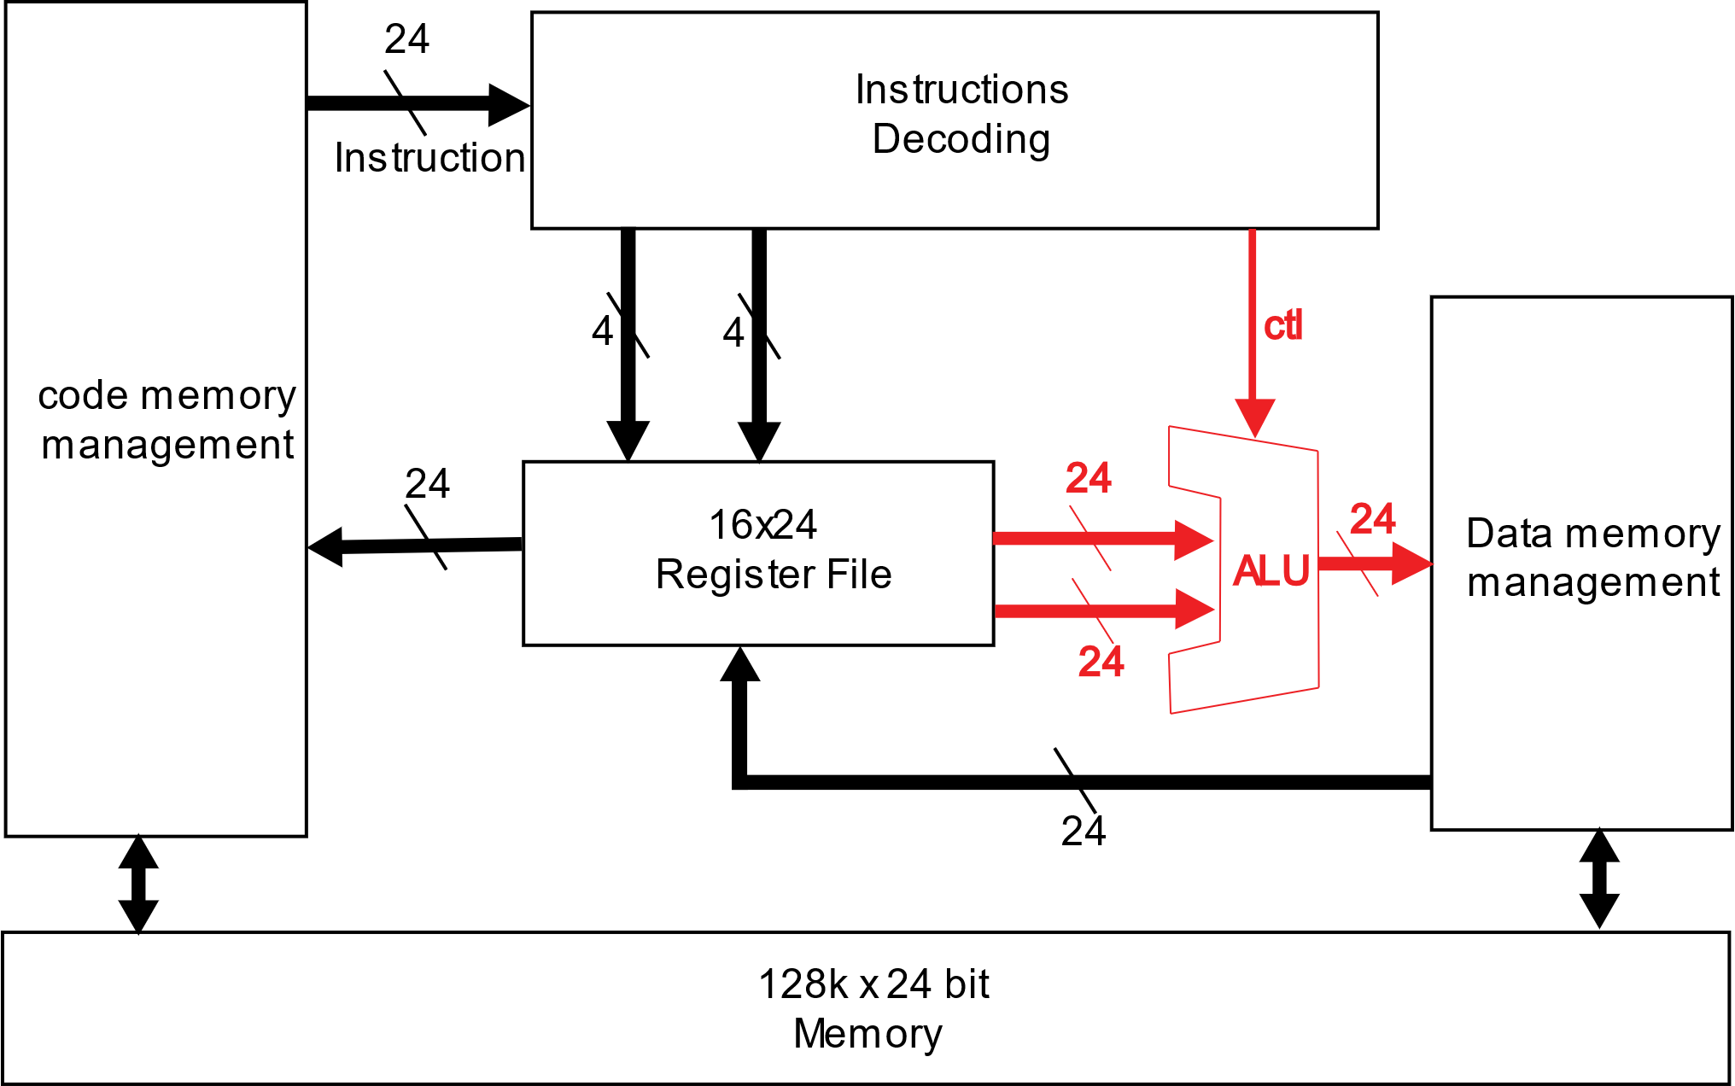
Systematic Overview
Fig 1. Systematic overview diagram of candy CPU

Slide 3
ALU Functions
Inst | Function | type | TypeCode | Opcode
add | Add | R | 00 | 000000
addi | Add immediate | I | 01 | 0000
sub | Sub | R | 00 | 000001
mul | Mul | R | 00 | 000010
div | Div | R | 00 | 000011
divu | Div unsigned | R | 00 | 000100
rem | Rem | R | 00 | 000101
remu | Rem unsigned | R | 00 | 000110
and | And | R | 00 | 001000
andi | And immediate | I | 01 | 0001
or | Or | R | 00 | 001001
ori | Or immediate | I | 01 | 0010
xor | Xor | R | 00 | 001010
xori | Xor immediate | I | 01 | 0011
sll | Shift left | R | 00 | 010000
slli | Shift left immediate | I | 01 | 0100
sra | Shift right arithmetic | R | 00 | 010001
srai | Shift right arithmetic immediate | I | 01 | 0101
srl | Shift right | R | 00 | 010010
srli | Shift right immediate | I | 01 | 0110
NEG | negative | R | 00 | 100000
NOT | not | R | 00 | 110000

Slide 4
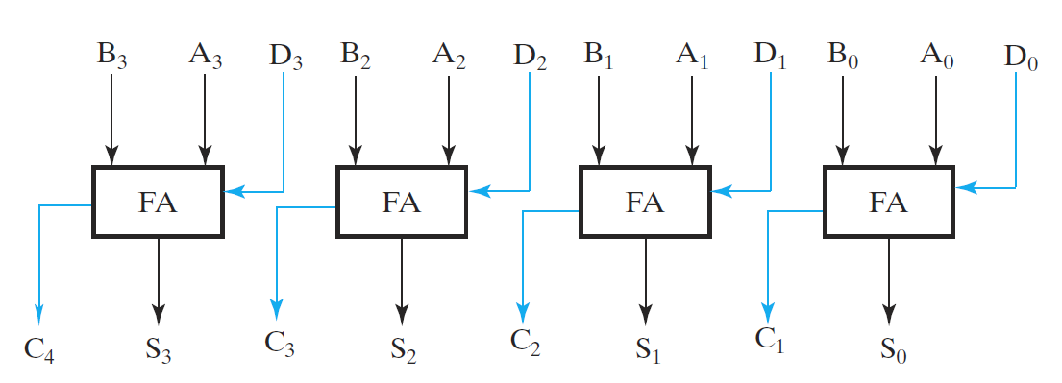
24-bit Carry-select Adder
24-bit add:
RD = RS1 + RS2
-- Using 24 Full adder
24-bit sub:
RD = RS1 + (~R2 + 1)
Fig 2. 4-bit carry select adder
cite: http://www.eng.ucy.ac.cy/theocharides/Courses/ECE210/Mulitpliers_Dividers_supp4.pdf

Slide 5
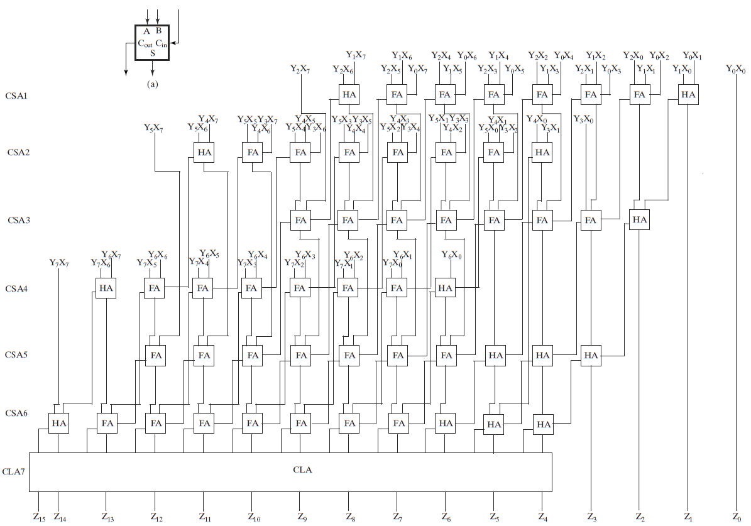
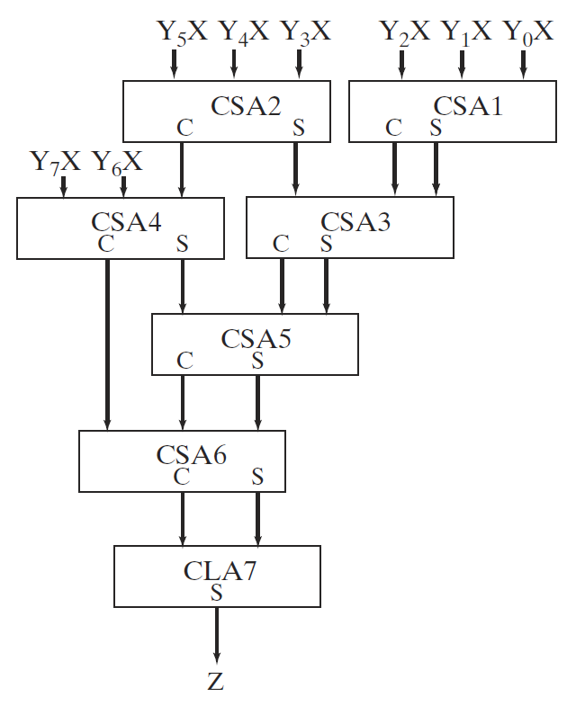
24-bit Wallace Tree Multiplier
26 bit CSA | 8
29-bit CSA | 5
34-bit CSA | 3
39-bit CSA | 1
42-bit CSA | 1
48-bit CSA | 2
55-bit CSA | 1
56-bit CSA | 1
cite: http://www.eng.ucy.ac.cy/theocharides/Courses/ECE210/Mulitpliers_Dividers_supp4.pdf

Slide 6
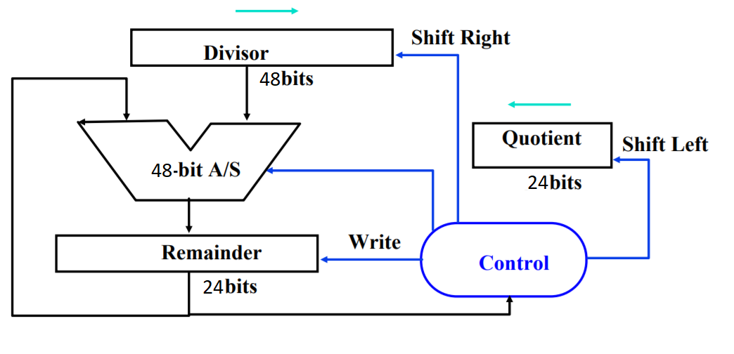
24-bit Divider

Slide 7
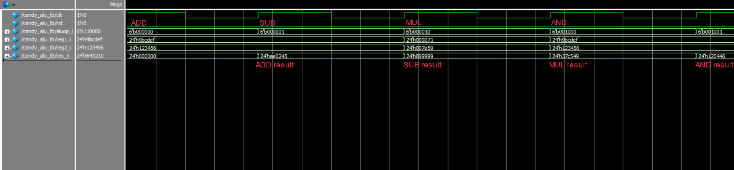
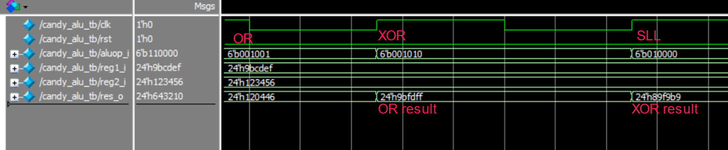
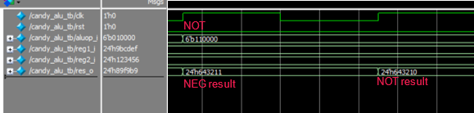
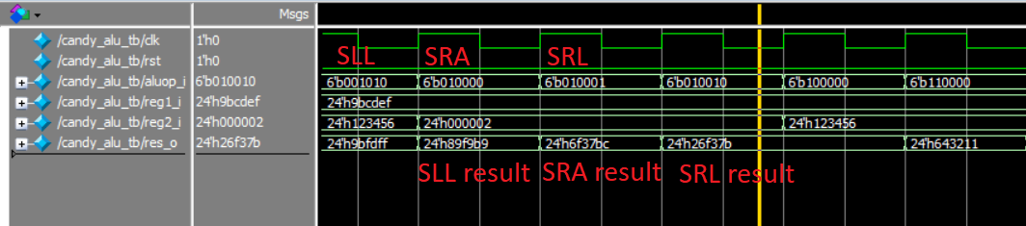
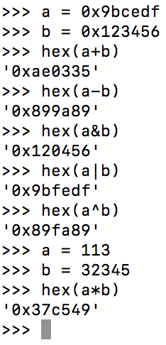
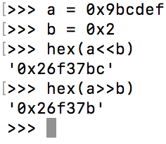
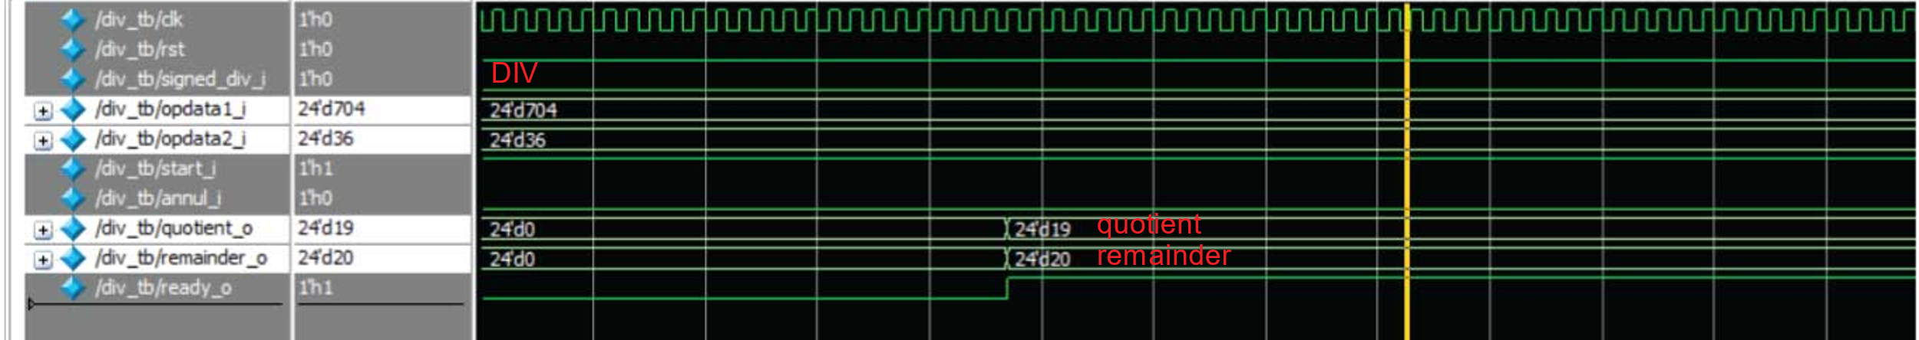
ModelSim Simulation Result

Slide 8
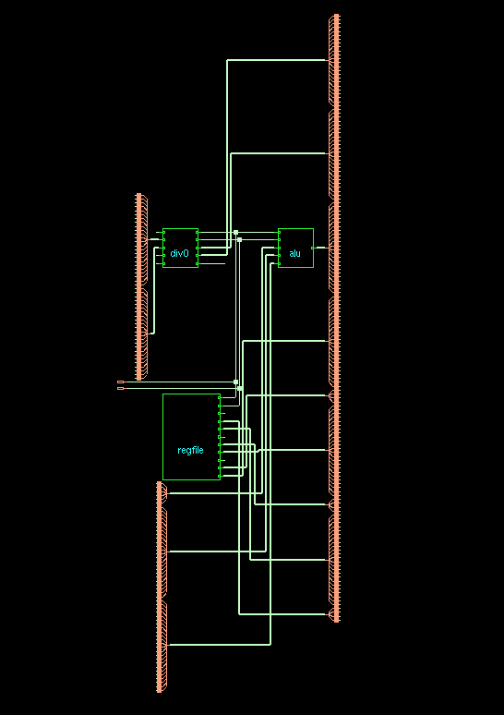
Synthesis
Top ALU Module

Slide 9
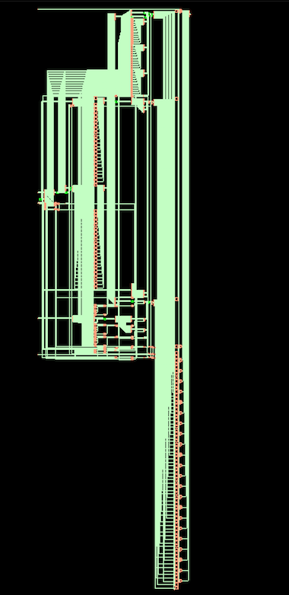
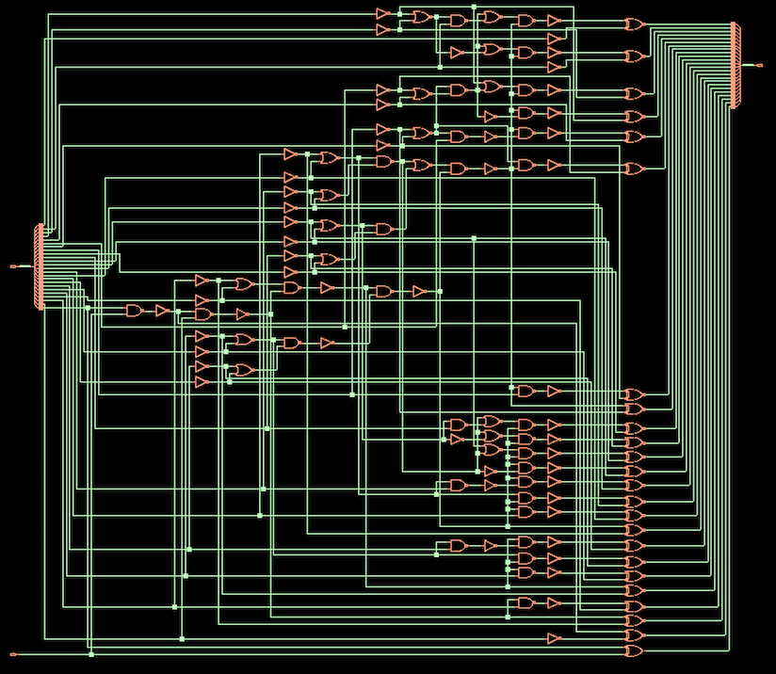
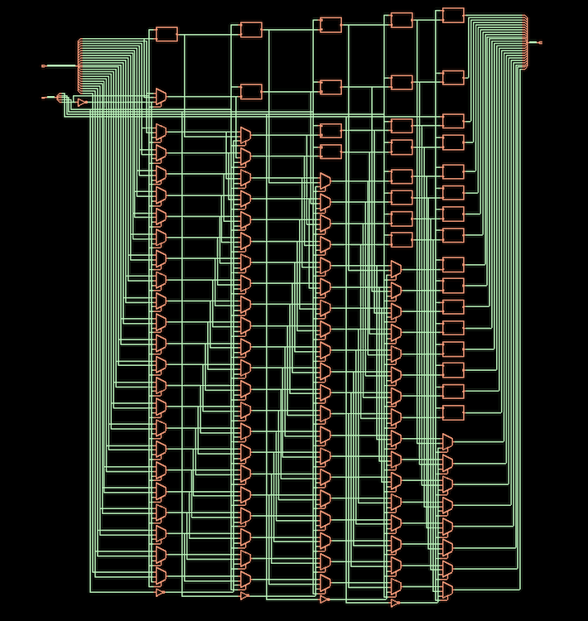
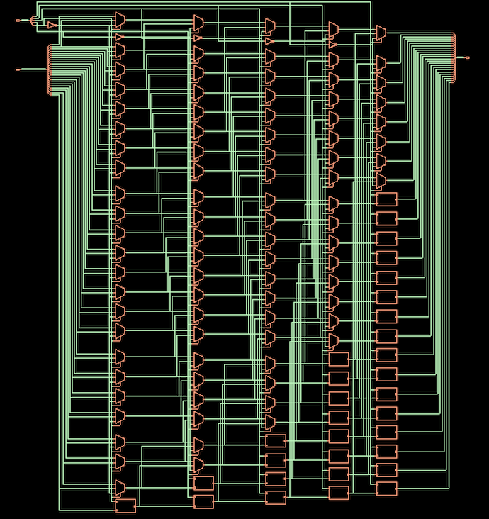
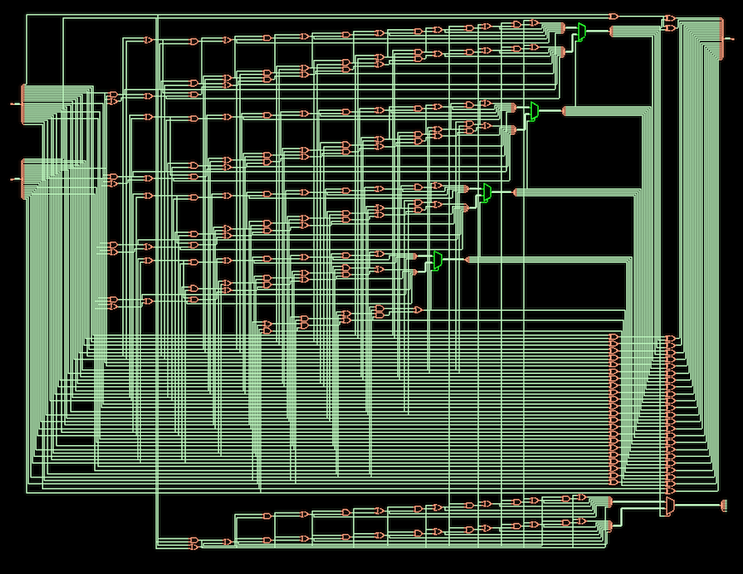
Adder
Shift right
Shift left
Logic
Operators
Overall Schematic

Slide 10
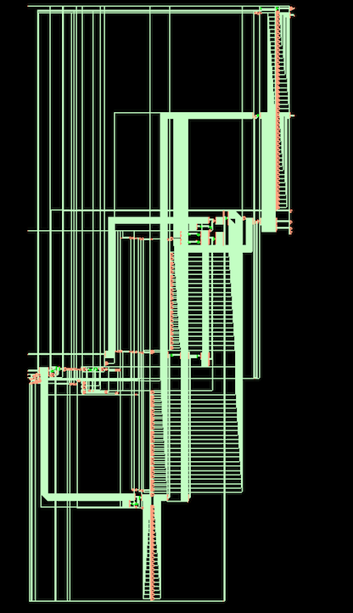
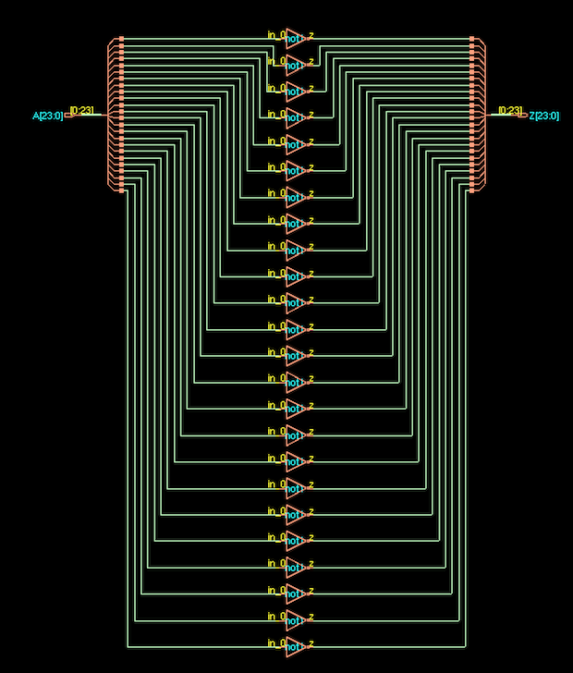
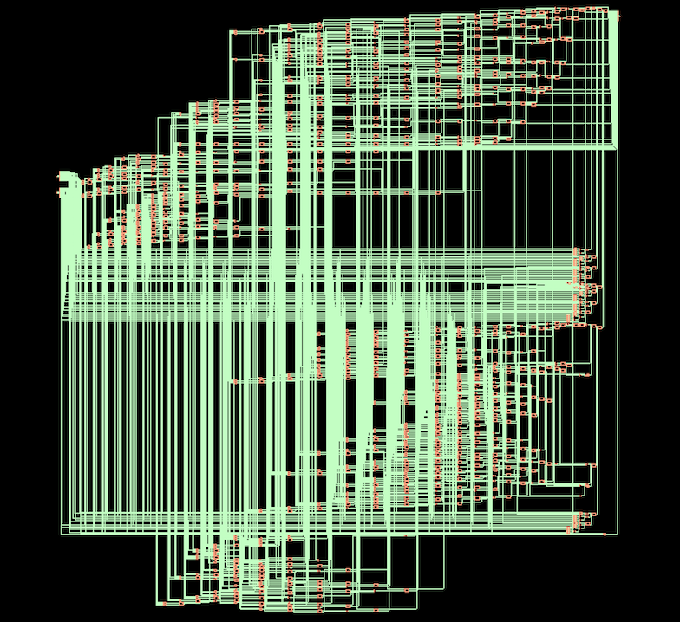
Div
NOT
Walltree

Slide 11
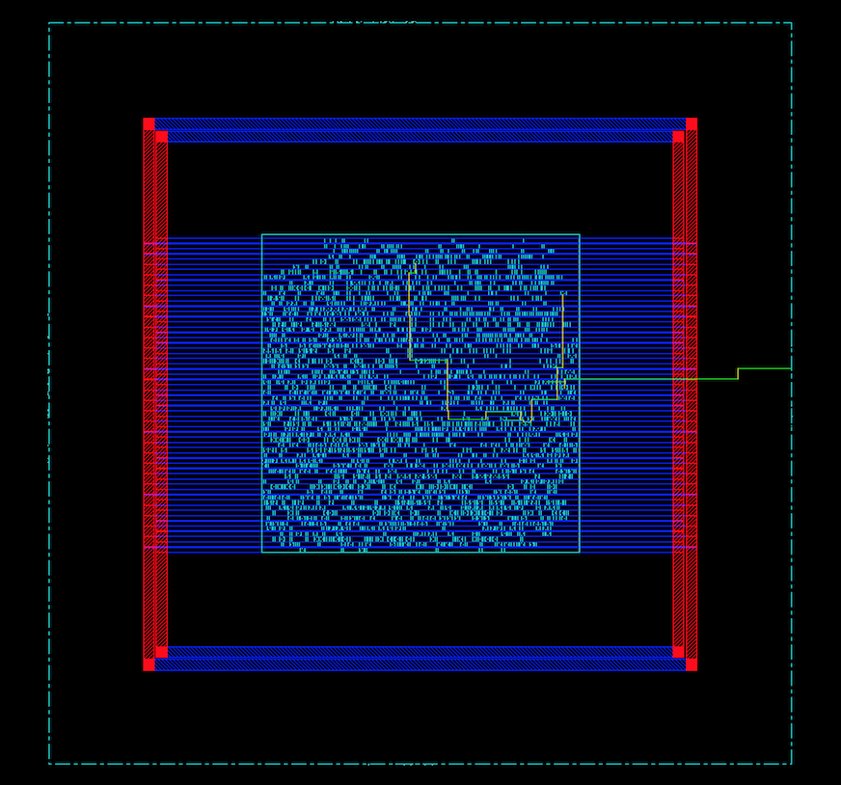
Place and Route
Layout after adding clock tree

Slide 12
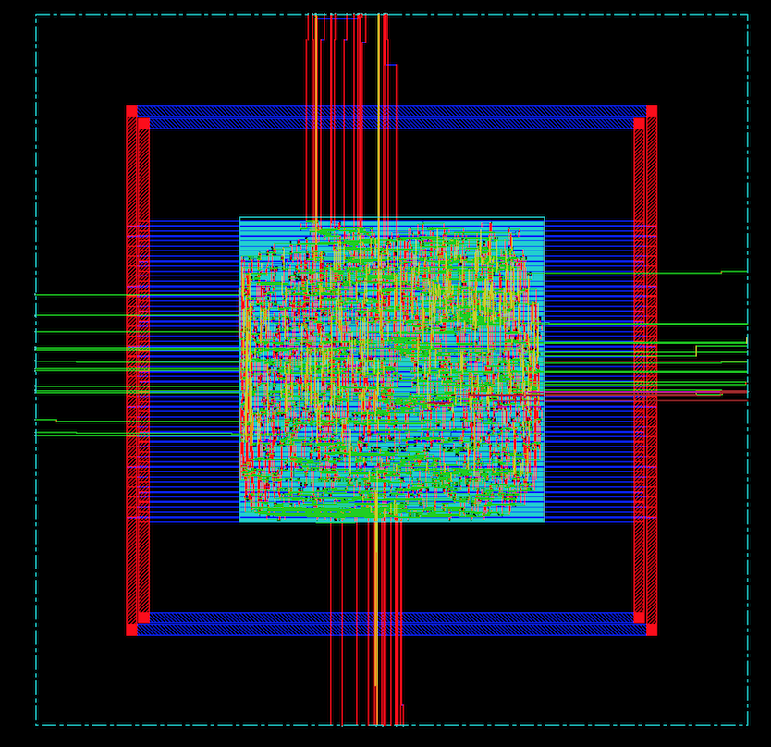
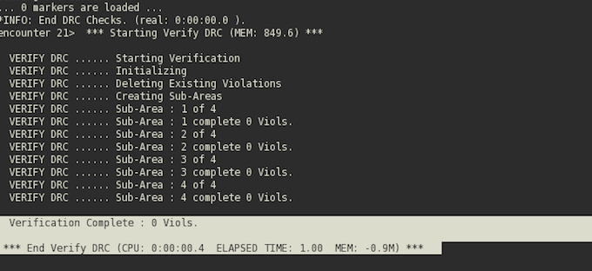
Layout after Routing

Slide 13
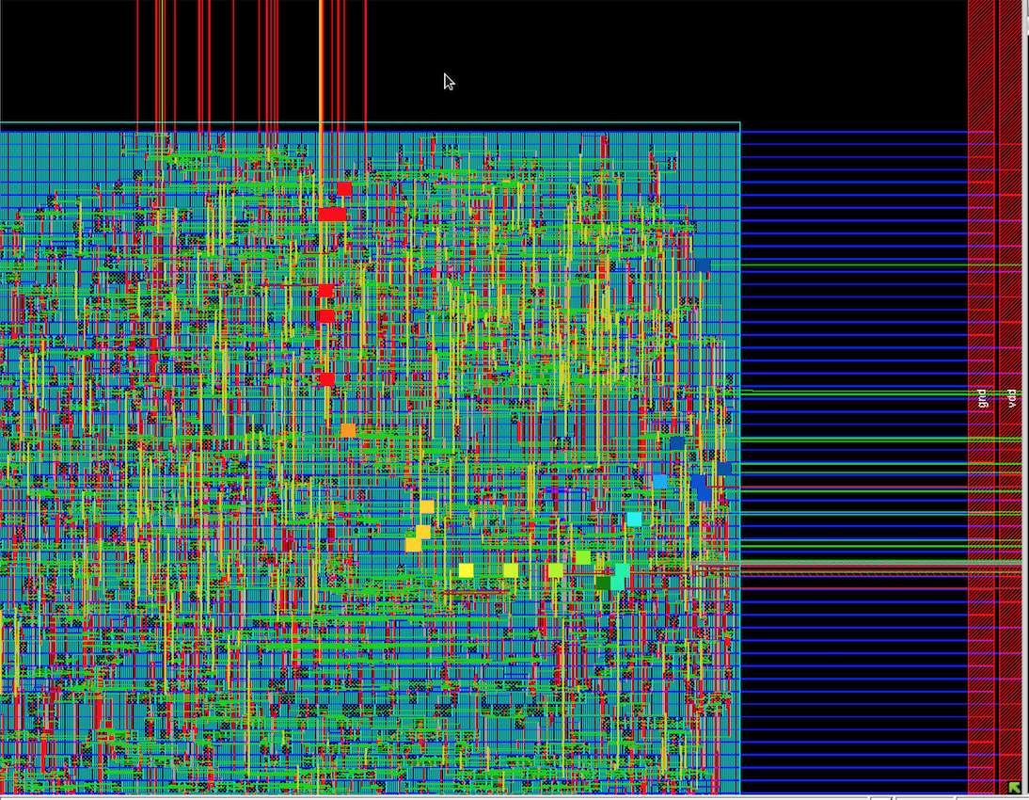
Timing delay

Slide 14
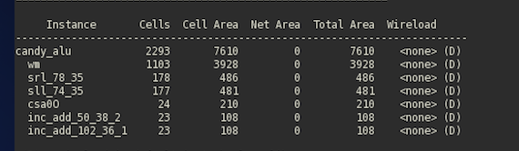
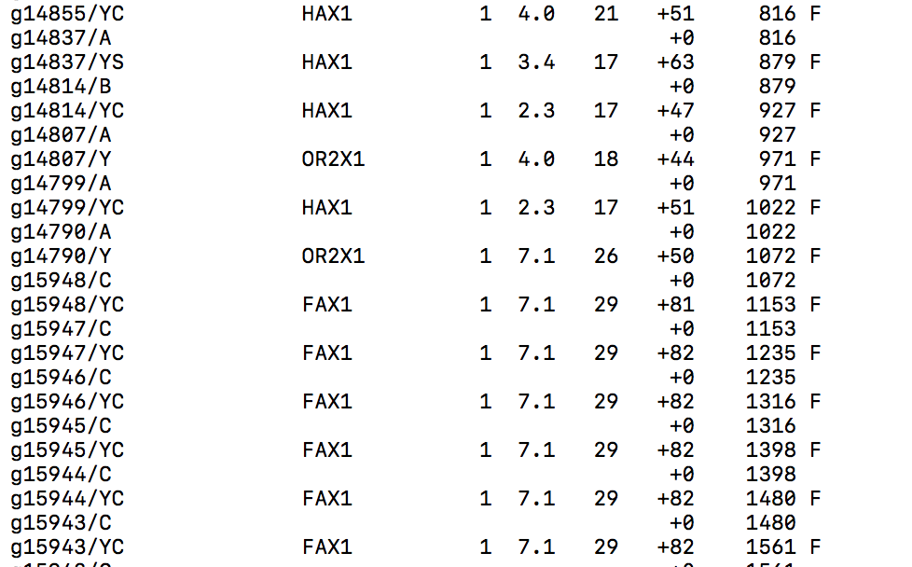
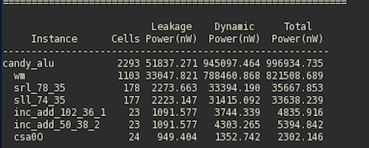
Size & Power Report
Area 7610
Timing 2580 ps
Power 996,934.735 nW

Slide 15
Question?

